Slide 1
5 : Introduction to bootstrap

Slide 2
Bootstrap Grid System

Slide 3
Introduction to Grids in Bootstrap
Bootstrap includes a responsive, mobile first fluid grid system that appropriately scales up to 12 columns as the device or viewport size increases
It includes predefined classes for easy layout options
It includes powerful mixins for generating more semantic layouts
Grid systems are used for creating page layouts through a series of rows and columns which hosts the content of a web page
The Grid is made up of groupings of Rows & Columns inside one or more containers

Slide 4
How Bootstrap grid system works
Rows must be placed within a “.container” class for proper alignment and padding
Use rows to create horizontal groups of columns
Content should be placed within columns
Columns may be immediate children of rows
Predefined grid classes like “.row” and “.col-xs-4” are available for quickly making grid layouts

Slide 5
How Bootstrap grid system works
Columns create gutters (gaps between column content) via padding
Padding is offset in rows for the first and last column via negative margin on “.rows”.
Grid columns are created by specifying the number of twelve available columns
For example:
  Three equal columns would use three “.col-xs-4”
  Two equal columns would use three “.col-xs-6”

Slide 6
Bootstrap Grids
Bootstrap grid system allows up to 12 individual columns
It allows to group the columns together to create wider columns too
These columns will re-arrange automatically depending on the screen size
You can use any combinations to prepare the layout
<div class="col-md-12">Span 12 columns</div>
<div class="col-md-6"> 6 units</div><div class="col-md-6"> 6 units </div>
<div class="col-md-4"> 4 units </div><div class="col-md-8"> 8 units </div>
<div class="col-md-4"> 4 units </div><div class="col-md-4"> 4 units </div> <div class="col-md-4"> 4 units </div>

Slide 7
Grid Classes
The Bootstrap grid system has four classes
  xs - focuses on mobile phones
  sm - focuses on tablets
  md - focuses on desktops
  lg - focuses on larger desktops
These classes can be used to create more dynamic, flexible and complex layout structures.

Slide 8
Basic Structure of a Bootstrap Grid
<div class="row">
<div class="col-*-*"></div>
</div>
<div class="row">
<div class="col-*-*"></div>
<div class="col-*-*"></div>
<div class="col-*-*"></div>
</div>
<div class="row">
...
</div>
Create a row (<div class="row">)
Add the desired number of columns (tags with appropriate .col-*-*classes)
Note that numbers in .col-*-
* should always add up to 12 for each row

Slide 9
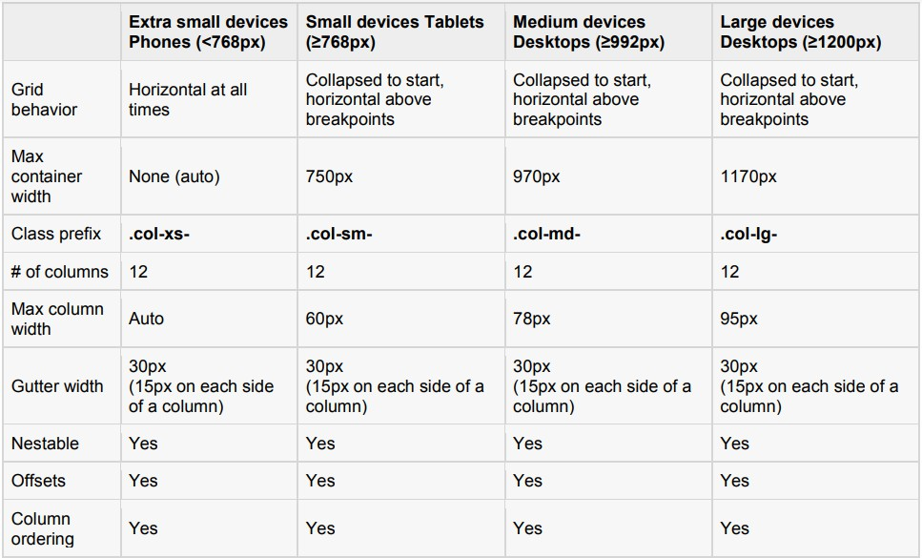
GRID Options

Slide 10
Media Queries
Media queries are conditional CSS rules.
It simply applies some CSS based on certain conditions
When the specified conditions are met, the style is applied
Media Queries in Bootstrap allows to move, show and hide content based on viewport size

Slide 11
Example media queries to create key break points
Extra small devices (phones, less than 768px)
No media query since this is the default in Bootstrap
Small devices (tablets, 768px and up)
@media (min-width: @screen-sm-min) { ... }
Medium devices (desktops, 992px and up) @media (min-width: @screen-md-min) { ... }
Large devices (large desktops, 1200px and up) @media (min-width: @screen-lg-min) { ... }

Slide 12
Basic example of single column
<div class="container">
<div class="row">
<div class="col">Single column grid</div>
</div>
</div>

Slide 13
Basic example of two column structure
<div class="container">
<div class="row">
<div class="col">column one</div>
<div class="col">column two</div>
</div>
</div>

Slide 14
Basic example of three columns
<div class="container">
<div class="row">
<div class="col"> left column </div>
<div class="col">center column</div>
<div class="col">right column</div>
</div>
</div>

Slide 15
The fundamental Rules of the Grid creation
Commonly three abstract level rules which are very useful
Columns must be the immediate child of a Row
Rows are only used to contain Columns, nothing else
Rows should be placed inside a Container
IMPORTANT
The Rows & Columns always work together

Slide 16
.container class
The Container can be used to hold any elements and content
It is not only used for holding the Grid Rows & Columns
It is very important to control width of the layout
The Container is also used to evenly align the left and right edges of
the layout within the browser’s viewport
The Container is used to counteract the negative margins of the Row
Viewport: The visible area inside the browser window

Slide 17
Types of containers in Bootstrap 4
Fixed-width container to center your layout in the middle:
<div class="container"></div>
Full-width container for a layout the spans the entire width:
<div class="container-fluid"></div>

Slide 18

Container fixed
The .container class provides a responsive fixed width container

Slide 19
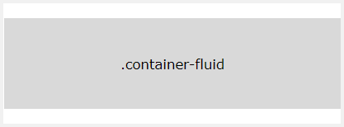
Container fluid
The .container-fluid class provides a full width container, spanning the entire width of the viewport

Slide 20
Responsive containers
.container-sm|md|lg|xl classes can be used to create responsive containers
The max-width of the container will change on different screen sizes/viewports depending on the device
<div class="container-sm">.container-sm</div>
<div class="container-md">.container-md</div>
<div class="container-lg">.container-lg</div>
<div class="container-xl">.container-xl</div>

Slide 21
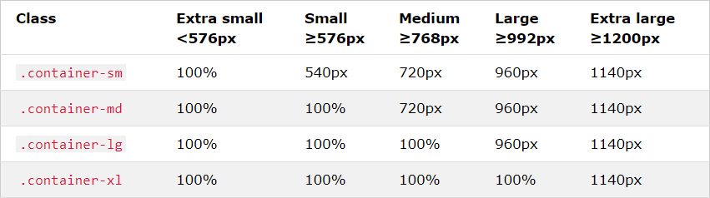
Maximum width change according to the viewport

Slide 22
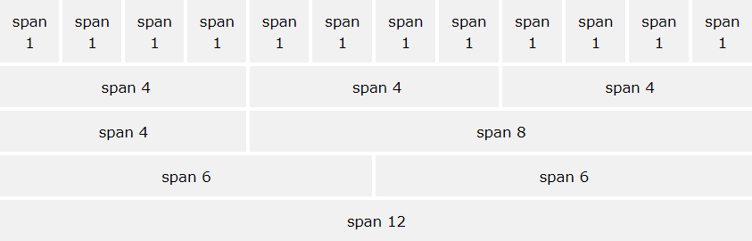
Grouping columns to create wider columns

